Slide 1
Introduction to Image Classification
Jordan Montgomery
July 20, 2020
Notes:
1
1
Check distro statement before using:
DISTRIBUTION STATEMENT A. Approved for pubic release: distribution is unlimited.
This material is based upon work supported under Air Force Contract No. FA8721-05-C-0002 and/or FA8702-15-D-0001. Any opinions, findings, conclusions or recommendations expressed in this material are those of the author(s) and do not necessarily reflect the views of the U.S. Air Force.
© 2020 Massachusetts Institute of Technology.
Delivered to the U.S. Government with Unlimited Rights, as defined in DFARS Part 252.227-7013 or 7014 (Feb 2014). Notwithstanding any copyright notice, U.S. Government rights in this work are defined by DFARS 252.227-7013 or DFARS 252.227-7014 as detailed above. Use of this work other than as specifically authorized by the U.S. Government may violate any copyrights that exist in this work.

Slide 2
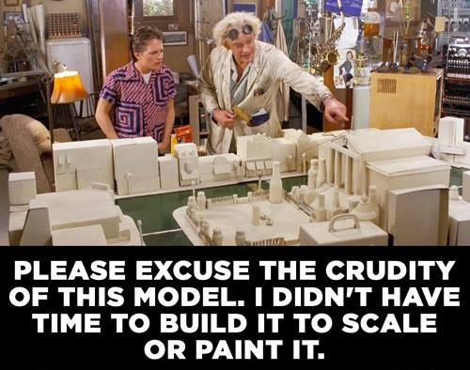

Slide 3
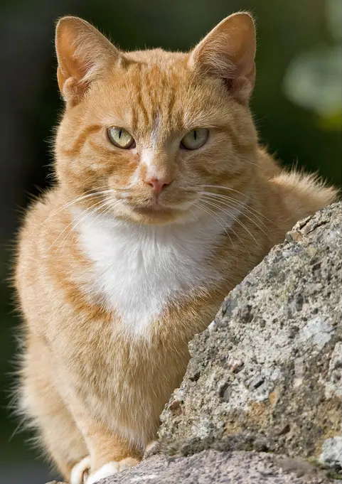
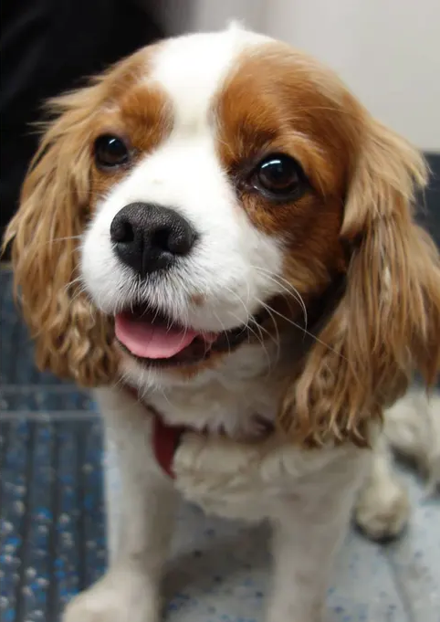
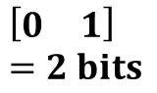
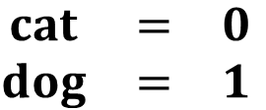
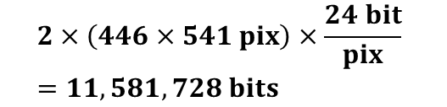
Images and Classifications
Images Often Contain More Information than We Need
Encoding Relevant Information
$$\begin{matrix}cat & = & 0 \\ dog & = & 1\end{matrix}$$
Data Representation
Data Compression
… 11.6 million bits reduce down to…
$$2×\left(446×541 pix\right)×\frac{24 bit}{pix} \\ =11,581,728 bits$$
Data Size
$$\left[\begin{matrix}0 & 1\end{matrix}\right] \\ =2 bits$$
Doctors do not care about every detail of an x-ray. They care if the bone is broken (0 or 1).

Slide 4
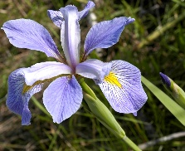
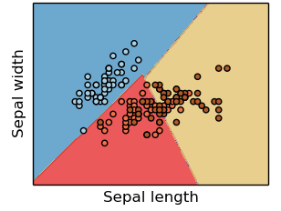
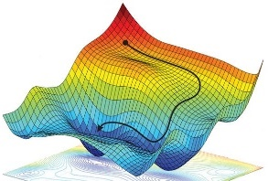
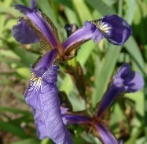
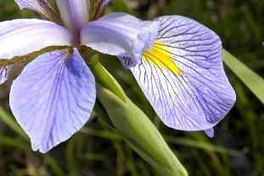
Necessary Components of a Supervised Machine Learning Approach
Training Data
Feature
Selection
Cost Function
Training Algorithm
Model Type
p
s
IrVi
IrSe
Set of labeled example data
Method to select data characteristics critical information
The form of model which will be trained to make decisions
Metric by which a prospective models should be judged
Algorithm to minimize the cost function by tuning model parameters
Description
- Tabular data
- Time-series
- Images
- Videos
- ASCII text
- Intuition
- Expert knowledge
- Statistics
- Learned features
- Regression
- Nearest neighbor
- Decision tree
- SVM
- Neural Network
- Squared error
- Absolute error
- Cross-entropy
- Accuracy
- Gradient descent
- Gradient-free opt.
- Analytic solution
Examples
Supervised machine learning approaches require each of these components
* image sources: scikit-learn (for “model type”) and https://reconsider.news/2018/05/09/ai-researchers-allege-machine-learning-alchemy (for “training algorithm”)

Slide 5
Necessary Components of a Supervised Machine Learning Approach
Training Data
Feature
Selection
Cost Function
Training Algorithm
Model Type
p
s
IrVi
IrSe
Set of labeled example data
Method to select data characteristics critical information
The form of model which will be trained to make decisions
Metric by which a prospective models should be judged
Algorithm to minimize the cost function by tuning model parameters
Description
- Tabular data
- Time-series
- Images
- Videos
- ASCII text
- Intuition
- Expert knowledge
- Statistics
- Learned features
- Regression
- Nearest neighbor
- Decision tree
- SVM
- Neural Network
- Squared error
- Absolute error
- Cross-entropy
- Accuracy
- Gradient descent
- Gradient-free opt.
- Analytic solution
Examples
Focus
Supervised machine learning approaches require each of these components
* image sources: scikit-learn (for “model type”) and https://reconsider.news/2018/05/09/ai-researchers-allege-machine-learning-alchemy (for “training algorithm”)

Slide 6
Outline
Introduction
Color Spaces
Images as Vectors
K-means Clustering
Summary

Slide 7
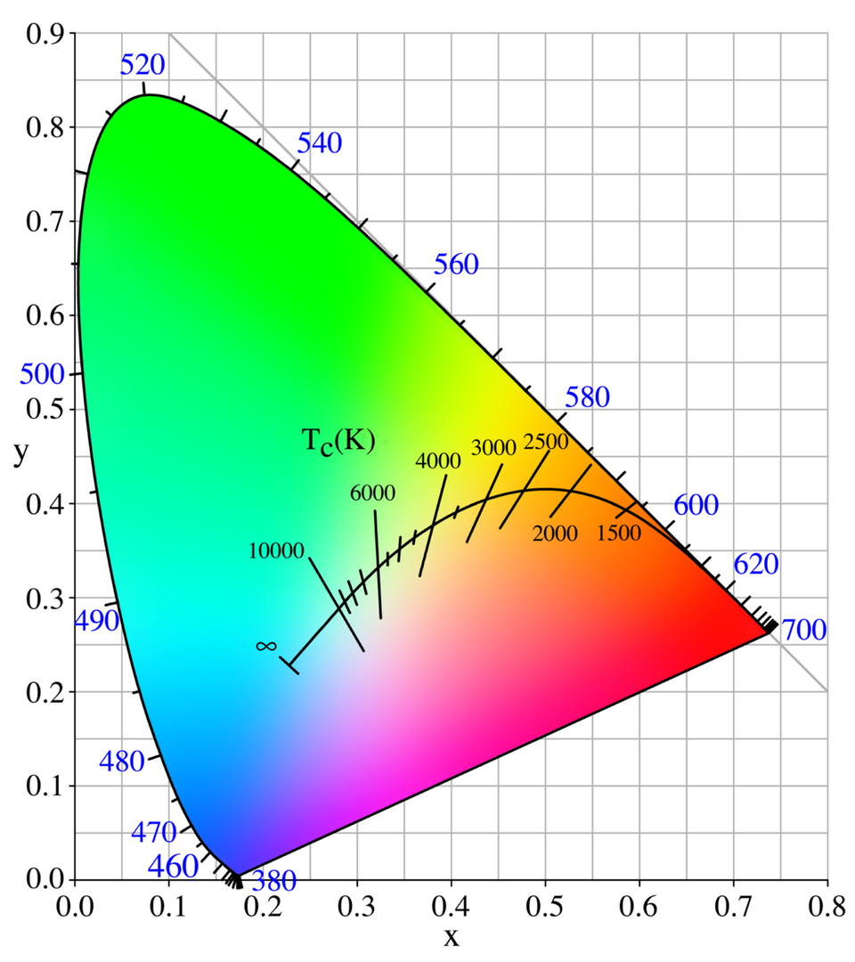
Chromaticity Diagram
Pure “monochromatic” colors along border
Represents only colors (not brightness)
Pure Single Wavelength Colors

Slide 8
Chromaticity Diagram
Pure “monochromatic” colors along border
Represents only colors (not brightness)
Illustrates how colors to be created by a mixture of two or more other “basis” colors
Basis colors may be driven by available technology (e.g., LCD or LED)
Pure Single Wavelength Colors
Basis Colors

Slide 9
Chromaticity Diagram
Pure “monochromatic” colors along border
Represents only colors (not brightness)
Illustrates how colors to be created by a mixture of two or more other “basis” colors
Basis colors may be driven by available technology (e.g., LCD or LED)
Area inside of triangle formed by basis colors is called the “gamut” of the colorspace
Colors outside of gamut cannot be created by those basis colors
Pure Single Wavelength Colors
Gamut
Basis Colors

Slide 10
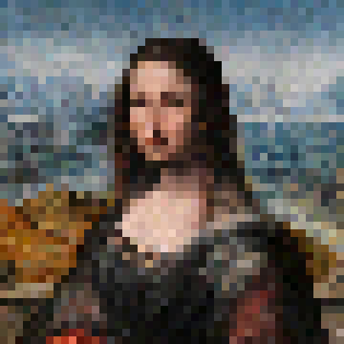
Greyscale
Each pixel has only one color specified
Typically represents an attempted average brightness across the visible range of light
May also simply be one specific color (e.g., just the red light)

Slide 11
Standard Red-Green-Blue (sRGB)
Each pixel has three colors specified
Each color is stored as an 8-bit number
Total of 24-bits per pixel
Total of 16,581,375 colors can be represented
Almost exclusively used by computer monitors
Some colors are outside of the sRGB gamut

Slide 12

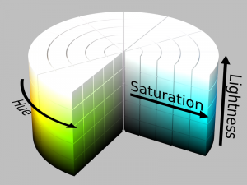
Hue-Saturation-Value/Lightness (HSV and HSL)
Hue: pure color value
0° red, 120° is green, 240° is blue, 360° red
Saturation: degree of colorfulness
0 is grayscale, 100 is the pure color
HSV
HSL
Value: range from black to pure color
0 is black, 1 is pure color
Lightness: range from black to white
0 is black, 1 is white

Slide 13
CIE L*a*b*
Intended to mimic sensitivity of human eye
L*: “luminance” (like brightness)
a*: Indicates extent along a green-magenta line in the chromaticity diagram
b*: Indicates extent along a blue-yellow line in the chromaticity diagram
Encompasses the RGB and HSV/HSL gamut
Useful for performing calculations without losing information
a*
b*

Slide 14

Question
Allison Q. Imager wants to produce a rainbow such as the one shown here. Which color-space would be easiest for her to use?
Greyscale
Red-Green-Blue
Hue-Saturation-Value
CIE L*a*b*

Slide 15
Question
Allison Q. Imager wants to produce a rainbow such as the one shown here. Which color-space would be easiest for her to use?
Greyscale
Red-Green-Blue
Hue-Saturation-Value
CIE L*a*b*

Slide 16
Outline
Introduction
Color Spaces
Images as Vectors
K-means Clustering
Summary

Slide 17

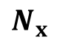
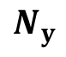
Flattening an Image
There are multiple representations of the same image data
Standard 2D Format
Flattened Vector Format
$$\left[\begin{matrix}206 & 000 & 075 & 175 & 248 & 245 & 171 & 183 & 182 & 213 & 232 & 144 & 023 & 007 & 163 & 163\end{matrix}\right]$$
$$N_{y}$$
$$N_{x}$$

Slide 18
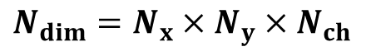
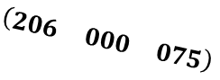
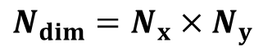
Each Pixel is a Dimension
Image Vector
$$\left[\begin{matrix}206 & 000 & 075 & 175 & 248 & 245 & 171 & 183 & 182 & 213 & 232 & 144 & 023 & 007 & 163 & 163\end{matrix}\right]$$
Pixel 3
Full image lives in (unvisualizable) high dimensional space
Pixel 2
Projection of First Three dimensions
$$N_{dim}=N_{x}×N_{y}$$
$$\left(\begin{matrix}206 & 000 & 075\end{matrix}\right)$$
Extra color channels further multiply the number of dimensions
$$N_{dim}=N_{x}×N_{y}×N_{ch}$$
Pixel 1

Slide 19
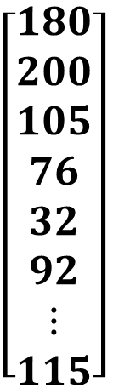

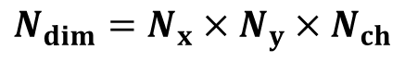
Each Unique Image Occupies a Unique Point in the Image Space
$$N_{dim}=N_{x}×N_{y}×N_{ch}$$
$N_{dim}$ dimensional image space
Image values can be any discrete number in range [0, 255] (8-bits)
One value per channel
greyscale: 8-bits per pixel
sRGB: 24-bits per pixel
Each unique image corresponds to a unique location in the high dimensional image space
$$\left[\begin{aligned}180 \\ 200 \\ 105 \\ 76 \\ 32 \\ 92 \\ ⋮ \\ 115\end{aligned}\right]$$
Class A
Class B
each image is a single position
vector values represent pixel values
each pixel-channel is an axis

Slide 20

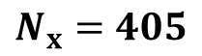
Question
How many dimensions in the following image assuming it is stored in sRGB format?
$$N_{x}=405$$
164025
492075
41826375
41990400
$$N_{y}=405$$

Slide 21
Question
How many dimensions in the following image assuming it is stored in sRGB format?
$$N_{x}=405$$
164025
492075
41826375
41990400
$$N_{y}=405$$

Slide 22
Question
How many unique images with the following shape are possible assuming the image is stored in sRGB format?
$$N_{x}=405$$
125971200
125479125
41990400
492075
$$N_{y}=405$$

Slide 23
Question
How many unique images with the following shape are possible assuming the image is stored in sRGB format?
$$N_{x}=405$$
125971200
125479125
41990400
492075
$$N_{y}=405$$

Slide 24
Outline
Introduction
Color Spaces
Images as Vectors
K-means Clustering
Summary

Slide 25
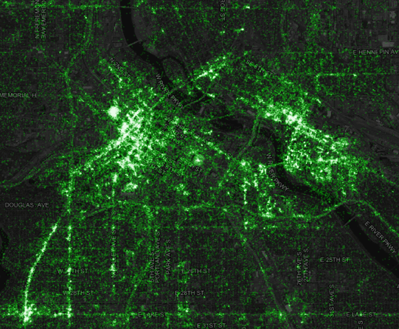
Clustering Problems
Papa Bob’s Pizza wants to open a set of new stores in your area!
The, CEO Bob DaBaker, has hired you to determine where his company should build their new stores. His company purchased some marketing data indicating addresses which have had pizzas delivered to them in the past year. That data is shown in the figure to the right.
How would you proceed to advise Bob on where he should build his new pizza shops?
Addresses which ordered pizza

Slide 26
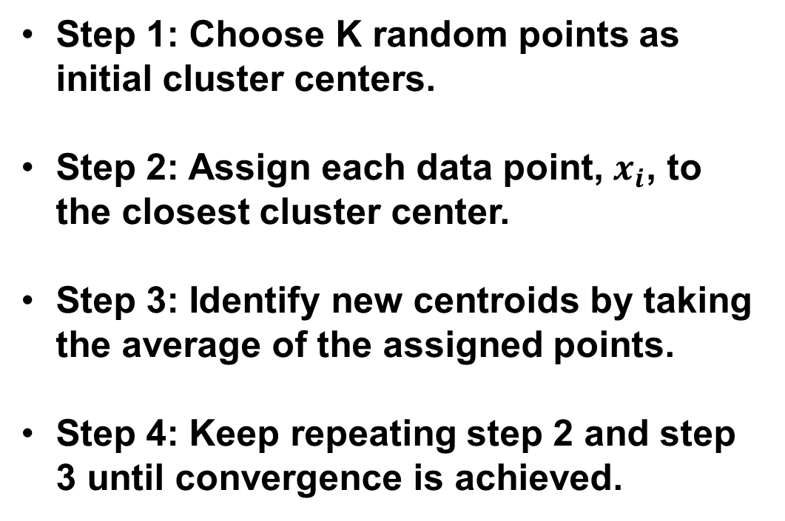
The K-means Algorithm
Step 1: Choose K random points as initial cluster centers.
Step 2: Assign each data point, $x_{i}$, to the closest cluster center.
Step 3: Identify new centroids by taking the average of the assigned points.
Step 4: Keep repeating step 2 and step 3 until convergence is achieved.
Where to open 10 pizza shops

Slide 27
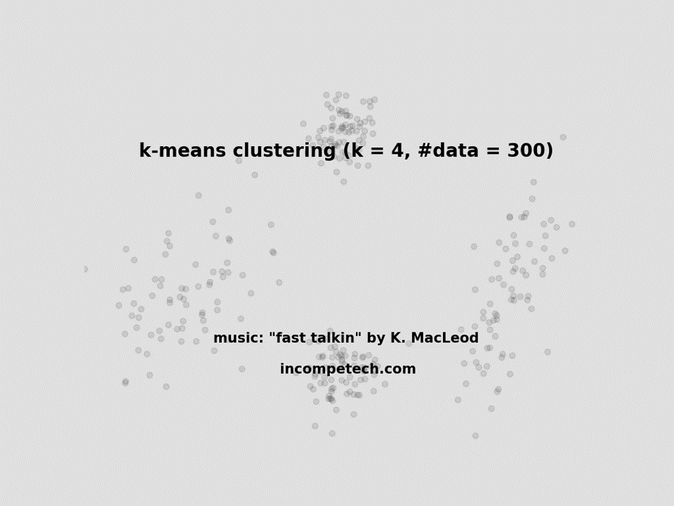
Animation of the K-means Algorithm

Slide 28
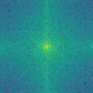
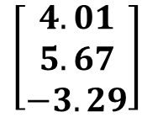
Applying K-means to Images
Raw Pixel Values
Clustering Dataspace
Original Image
206
000
075
175
248
245
171
183
182
213
232
144
023
007
163
163
Class A
Image Features
DFT
Feature Extractor
$$\left[\begin{matrix}4.01 \\ 5.67 \\ −3.29\end{matrix}\right]$$
Class B

Slide 29
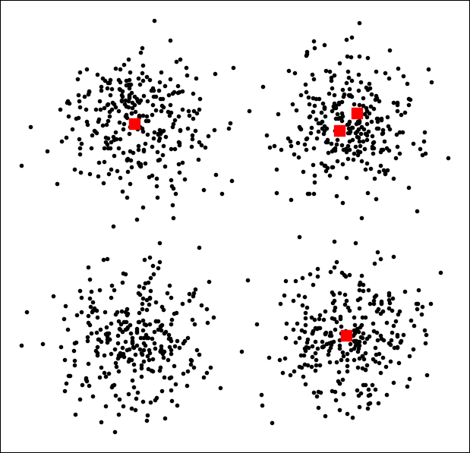
Question
What will happen if the cluster starting points are here?
All of the cluster centers will gravitate toward the upper right
The two centers in the upper right cluster will stay stuck there
There is randomness involved so it is impossible to say
Everything will proceed as normal

Slide 30
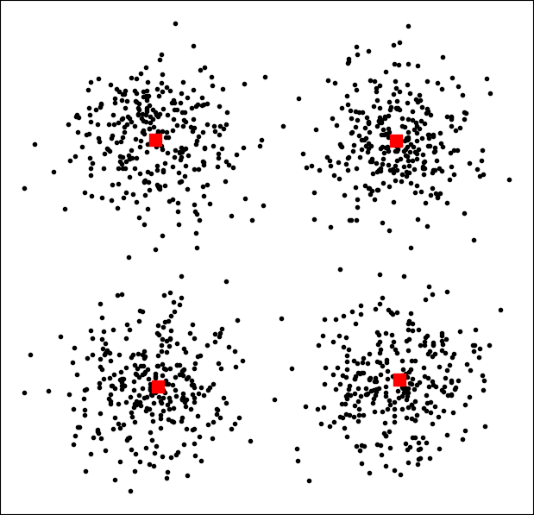
Question
What will happen if the cluster starting points are here?
All of the cluster centers will gravitate toward the upper right
The two centers in the upper right cluster will stay stuck there
There is randomness involved so it is impossible to say
Everything will proceed as normal

Slide 31
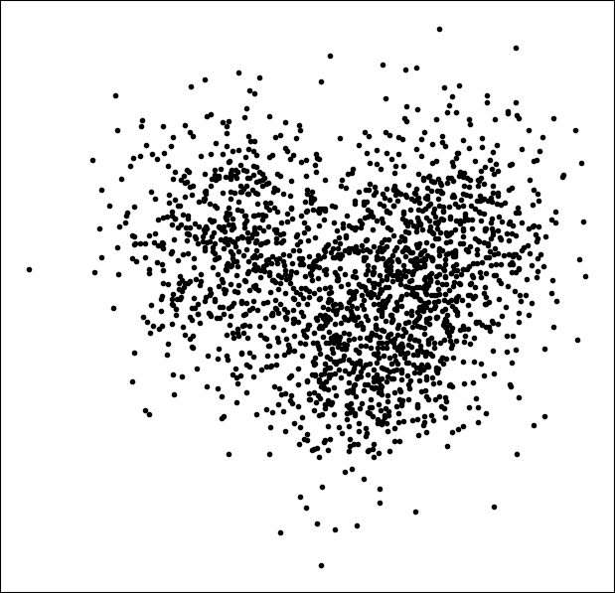
Question
How many initial cluster centers should be used here?
1
2
3
4

Slide 32
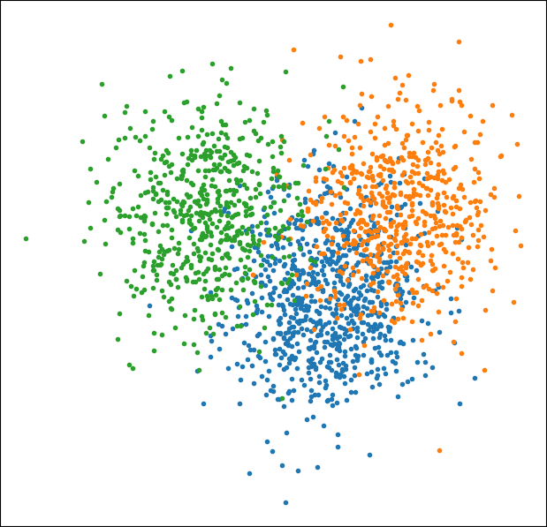
Question
How many initial cluster centers should be used here?
1
2
3 ?? ← not clear!
4

Slide 33
Summary
Much of the information in an image is captured by only recording pixel brightness
Sometimes no color is available
Saves image space (and processing power)
There are many ways to represent color in an image
Not all colors can be represented by standard Red-Green-Blue color space
Images can be flattened into a vector representation without losing any information
These vectors represent a high dimensional image space
Each image vector points to a unique location in image space
Extracted image features can capture descriptive information about signal properties
Co-occurrence matrix describes image texture
Other image features
K-means clustering can be applied to raw images or image features to cluster images with similar characteristics together

Slide 34

